Slide 1
Principles of Incident Management - Field Perspective
CGPRT(W) : Ensuring Clean Seas and Coasts in Western Region ……

Slide 2
Objective
To understand the principles of incident management from the field perspective including operational organization and management, communications and reporting and dealing with media.
CGPRT(W) : Ensuring Clean Seas and Coasts in Western Region ……

Slide 3
Introduction
The early stages of a response incident are often confused and stressful with competing priorities, few resources and little information.
Effective incident management requires turning this opening “crisis” phase into a structured response in the shortest possible period: “Crisis to Project”.
This can best be achieved by utilizing an incident management system (IMS)
CGPRT(W) : Ensuring Clean Seas and Coasts in Western Region ……

Slide 4
Introduction
Authoritative command is carried out by those who have been given authority over others for a specific operation or incident.
Incident commanders should:
  make decisions
  give clear directions
  ensure these directions are carried out.
This promotes cohesion and provides direction to deliver the response strategy.
CGPRT(W) : Ensuring Clean Seas and Coasts in Western Region ……

Slide 5
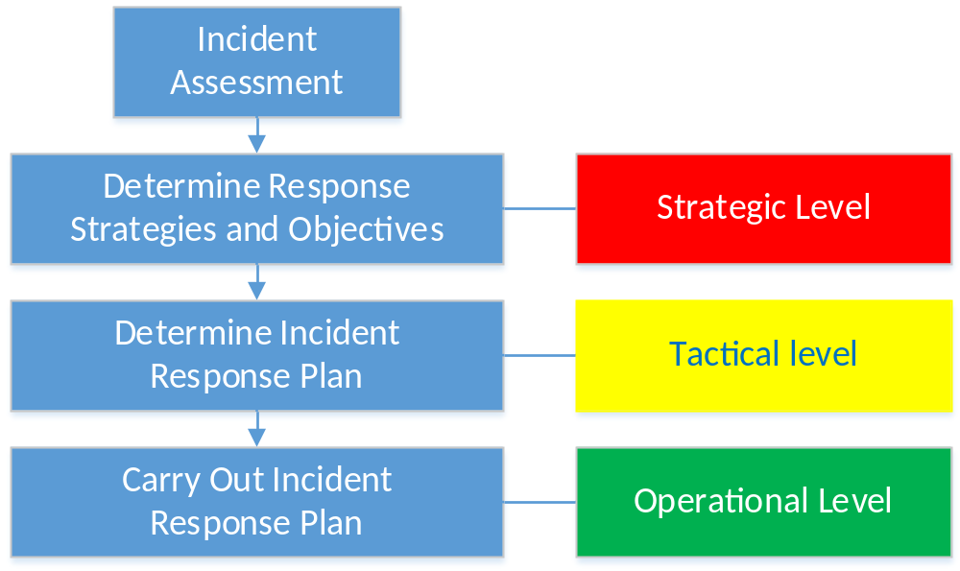
Introduction
CGPRT(W) : Ensuring Clean Seas and Coasts in Western Region ……

Slide 6
Response Planning Cycle
Effective management requires a systematic approach.
This is a continual process of identifying and addressing the unique risks posed by a particular incident.
In the simplest form this process has four steps:
  Incident assessment
  Planning and decision making
  Implementation
  Monitoring and review.
CGPRT(W) : Ensuring Clean Seas and Coasts in Western Region ……

Slide 7
Response Planning Cycle
Incident assessment (situation)
Planning and decision making
Implementation
(operations)
Monitoring and review
CGPRT(W) : Ensuring Clean Seas and Coasts in Western Region ……

Slide 8
Response Planning Cycle
Incident assessment
  Evaluation of the incident, in particular the identification and prioritization of the environmental and socio-economic resources threatened by the incident.
Planning and decision making
  The development, consideration and selection of appropriate strategies to respond to the incident.
CGPRT(W) : Ensuring Clean Seas and Coasts in Western Region ……

Slide 9
Response Planning Cycle
Implementation
  The operational implementation of the selected response strategies.
Monitoring and review
  Evaluation of the effectiveness of the implemented response strategies and the measurement of progress towards the response objectives and ultimately, terminating the response. This requires feedback from the field.
CGPRT(W) : Ensuring Clean Seas and Coasts in Western Region ……

Slide 10
Incident Response Objectives
An effective response requires the implementation of a series of actions to meet the overall objectives.
The Incident Action Plan (IAP) pulls together the incident objectives, strategies and tactics.
CGPRT(W) : Ensuring Clean Seas and Coasts in Western Region ……

Slide 11
Incident Action Plan
An IAP is developed for a specified period of time.
It describes the activities and logistical support required during that period.
It is a “living document” and subject to amendment and updating as the latest information is received.
CGPRT(W) : Ensuring Clean Seas and Coasts in Western Region ……

Slide 12
Response Planning
There are different approaches to this subject across the world.
These may be tailored to the incident size or complexity.
Ensure you are familiar with your system and your function within that system?
Where would you find information on your system and your role within it?
CGPRT(W) : Ensuring Clean Seas and Coasts in Western Region ……

Slide 13
Incident Management
Incident management systems are generally built around five MAJOR functions:
  Command
  Planning
  Operations
  Logistics
  Finance
These functions are delivered through an incident management team.
Command Function
Planning Function
Logistics
Function
Finance Function
Operations Function
CGPRT(W) : Ensuring Clean Seas and Coasts in Western Region ……

Slide 14
Incident Command
Command function is responsible for:
  the overall management of an incident
  setting the objectives of the response
  setting the priorities of the response.
In addition it may also be responsible for:
  public affairs and media liaison
  legal issues
  overall incident safety
  inter-agency liaison
  inter-region liaison.
CGPRT(W) : Ensuring Clean Seas and Coasts in Western Region ……

Slide 15
Incident Command
Generally a single individual or organization will fulfil the command function.
If the incident is complex with a large number of stakeholders (government to government internationally, national and local government agencies, industry, etc.) it may be appropriate to implement a combined command function.
Command responsibilities maybe be listed in the IAP but should be defined prior to the incident in such as national and facility contingency plans so that the responsibilities of the different organizations are clearly understood.
CGPRT(W) : Ensuring Clean Seas and Coasts in Western Region ……

Slide 16
Operations Function
The operations function is responsible for the management of all activities within the incident and the management of all resources deployed in the field.
Operations are organized into divisions on the basis of geography or the operations being conducted according to the type, demands and complexity of the incident.
Divisions can be further broken into sectors, teams or resources as required.
CGPRT(W) : Ensuring Clean Seas and Coasts in Western Region ……

Slide 17
Operations Function
Operations Function
Aviation Division
Health & Safety
Waste Management
Shoreline Division
Wildlife Division
Marine Division
Aerial Dispersants
Aerial Surveillance
Marine Containment & Recovery
Marine Dispersants
Sector A
Sector B
Response Team B
Response Team A
Response Team A
Response Team B
A typical layout: must be adjusted to fit your incident
CGPRT(W) : Ensuring Clean Seas and Coasts in Western Region ……

Slide 18
Response Teams
Identified sectors will be controlled by a Beach supervisor/manager
  responsible for the clean-up operations within the sector.
Supported by response teams
  headed by a Team leader.
CGPRT(W) : Ensuring Clean Seas and Coasts in Western Region ……

Slide 19
Use of Volunteers
In the event of a manual clean-up operation the use of volunteers may be considered.
If this is considered then issues of liability and health and safety regulations need to be addressed:
  legal release of liability
  safety and operational training
  suitable job roles and responsibilities
  sufficient and appropriate PPE.
CGPRT(W) : Ensuring Clean Seas and Coasts in Western Region ……

Slide 20
Use of Volunteers
Advantages
  Local knowledge (especially fishermen or shore/water users).
  Effective way of filling manpower requirements.
  Volunteers have a stake in the local environment.
CGPRT(W) : Ensuring Clean Seas and Coasts in Western Region ……

Slide 21
Use of Volunteers
Disadvantages
  often untrained in spill response operations and health and safety, so will require training and close supervision;
  will require PPE, supplies, logistical support and on-site management and supervision;
  cannot be relied upon to assist daily or for long periods;
  may be insurance cost implications;
  may cause tension with professional, paid, staff.
CGPRT(W) : Ensuring Clean Seas and Coasts in Western Region ……

Slide 22
Use of Vessels of Opportunity in Spill Response
Depending on the nature of the oil spill, there may be a need to mobilize ‘vessels of opportunity’ to assist in the response:
  Typically owned and operated by professional or recreational fishermen dedicated to capturing fish, gathering shellfish or to aquaculture, but may include other boat operators.
Fishermen in oil spill response may be effective in coastal sea areas due to:
    local knowledge of the shoreline and coastal waters;
    availability of fishing gear that may be useful for recovery operations;
    availability to offer their collaboration.
CGPRT(W) : Ensuring Clean Seas and Coasts in Western Region ……

Slide 23
Examples of Roles and Tasks for Vessels of Opportunity
Fishermen – deploy traditional gears, booms and trawl nets for oil containment and recovery.
Fish farmers – use ropes, bags, nets, cages, tanks and barges which may be useful in oil recovery, transporting waste/people, or preventing oil from reaching the shoreline.
Shellfish farmers – drive barges to conduct surveys in shallow waters, assist protection of sensitive sites.
Kelp harvesters – recover thick viscous oil with their on-board gear and store it on board.
Divers – assist submerged slick recovery operations or assist to set up boom mooring systems.
Other boat operators – transport responders or observers, provision of logistical support.
CGPRT(W) : Ensuring Clean Seas and Coasts in Western Region ……

Slide 24
Possible Response Operations by Vessels of Opportunity
Alert, surveying and sampling
Oiled shoreline assessment – particularly where access from the sea is necessary
Response operations:
  Chemical dispersion
  Containment
  Recovery operations
  Protection of the shoreline
Waste storage and transportation
Wildlife recovery and rescue
Logistical support
CGPRT(W) : Ensuring Clean Seas and Coasts in Western Region ……

Slide 25
Elements to Consider in Using Vessels of Opportunity
  Adherence to relevant national regulations on the use of vessels of opportunity where applicable
  Health and safety aspects addressed
  Effectiveness of deployment considered
  Integration of fishermen/VOOs within the chain of command
  Coordinator/manager within spill management team responsible for their deployment and activities
  Communication system among operators for unambiguous flow of information
  Definition of their specific roles and responsibilities
  Delivery of on-the-spot training courses
  Daily updates
  Payment and compensation
CGPRT(W) : Ensuring Clean Seas and Coasts in Western Region ……

Slide 26
Operational Health & Safety
The Health and safety function with operations is to provide operational guidelines and oversight of work practices during response operations.
The safety of response personnel and the public is paramount.
The development of specific and appropriate guidelines and the monitoring of operations to ensure safe working conditions is required throughout the response.
CGPRT(W) : Ensuring Clean Seas and Coasts in Western Region ……

Slide 27
Incident Facilities
Major incidents require a number of facilities to effectively manage an incident.
These may include:
  Incident Command Centre (ICC)
  Forward Command Point(s) (FCP)
  Staging or assembly areas
  Temporary waste storage areas
  Decontamination areas
  Joint Information Centre
CGPRT(W) : Ensuring Clean Seas and Coasts in Western Region ……

Slide 28
Communications
Proper and adequate lines of communication (communications plan)
Strict radio discipline
Consider use of standard forms for reporting progress/degree of oiling
Field reports are critical
CGPRT(W) : Ensuring Clean Seas and Coasts in Western Region ……

Slide 29
Dealing with the Media
Interest from media unpredictable.
Informing the media is important.
NOT normally a job for first responders but you may be approached in the field.
  Only comment on the work you are carrying out.
  Do not comment on policy issues − stick to your area of responsibility.
  Refer other questions to Supervisor/Media Officer.
CGPRT(W) : Ensuring Clean Seas and Coasts in Western Region ……

Slide 30
Dealing with the Media
If approached:
  Don’t offer a personal opinion.
  Beware of language, behave politely and be patient.
  Press must observe safety rules.
Be aware that your cell phone may be a safety risk.
The taking and sharing of photographs on social media needs to be approved by the Incident Command.
CGPRT(W) : Ensuring Clean Seas and Coasts in Western Region ……

Slide 31
Any questions?
CGPRT(W) : Ensuring Clean Seas and Coasts in Western Region ……

